Slide 1
MultiNest for NEMESIS:
An intro to ellipsoidal nested sampling with NEMESIS, including examples and installation
Ryan Garland
&
Prof. Patrick G.J. Irwin

Slide 2
Part One:
An introduction to
Nested Sampling & MultiNest

Slide 3
WHY NESTED SAMPLING? BACKGROUND ON OPTIMAL ESTIMATION
NEMESIS by default uses optimal estimation as its inverse method. This is an extremely efficient inverse method, if your prior is close to your true answer.
However, a large range of priors must be investigated to ensure your solution is not degenerate.This includes creating a grid of priors with means and (co)variances of each parameter which are largely unknown. There is always the chance that parameter space is not fully explored, and the converged solution is not the best fit to the data.
As well as this prior grinding issue, OE assumes that all errors are Gaussian, which is not necessarily the case.

Slide 4
WHY NESTED SAMPLING? BACKGROUND ON OPTIMAL ESTIMATION
Prior far from true solution
Prior close to true solution

Slide 5
WHY NESTED SAMPLING? AN INTRO
Nested Sampling is an inverse method which
calculates the Bayesian evidence by sampling the posterior distribution, and produces probability distribution functions for each parameter as a by-product.
does not assume anything about the shape of the probability distributions (OE assumes Gaussian)
it fully explores parameter space (no more prior gridding)
fully explores all degenerate solutions (multi-modal solutions now possible)
automatically calculates the Bayesian evidence (can directly compare two different models, and which model is more appropriate when taking into account the number of free parameters in the model)

Slide 6
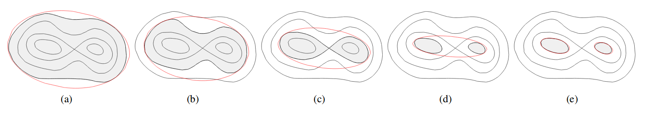
WHAT iS MULTINEST? THE ALGORITHM
MultiNest is a simultaneous ellipsoidal nested sampling algorithm. In plain English, the procedure of the algorithm goes like this:
Set up a range for your parameters (a uniform prior). For example, logVMR of H2O is between [-10,-1].
Normalise all of these ranges to be between 0 and 1. This creates a unit hypercube in parameter space. (N-dimensional cube with x,y,z etc between 0 and 1).
Run MultiNest. It uniformly samples the hypercube with ‘live points’ (state vectors), and fits a bounding ellipsoid around these points.
Checks are made to see if the posterior is multi-modal, and if this is true a k-means algorithm in applied recursively to split the ellipsoid into pairs of ellipsoids. (See Figure)
An associated spectrum is calculated with each live point, and compared to the data to calculate a probability (like a chi-squared).
The lowest probability live point is removed. A new live point is created, and a new bounding ellipsoid is calculated. Repeat from step 4.
Ends once a convergence criterion is met (change in Bayesian log-evidence 0.1).

Slide 7
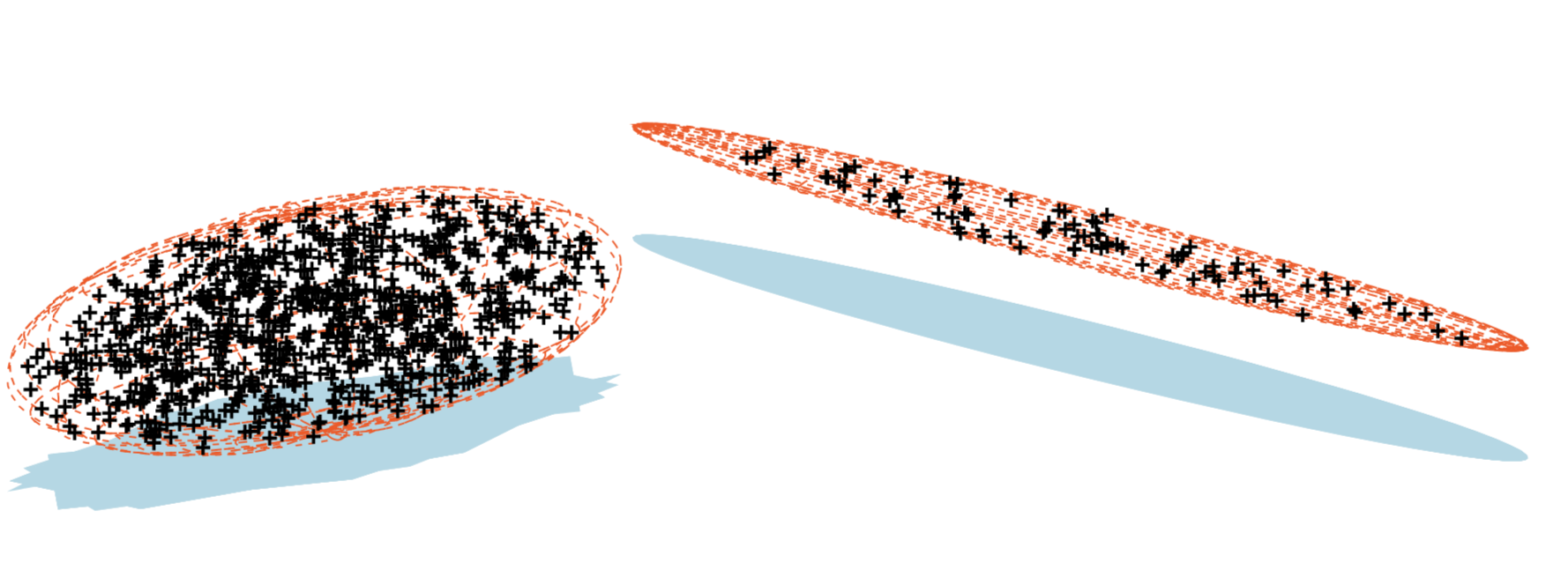
WHAT iS MULTINEST? MULTIMODAL POSTERIOR

Slide 8
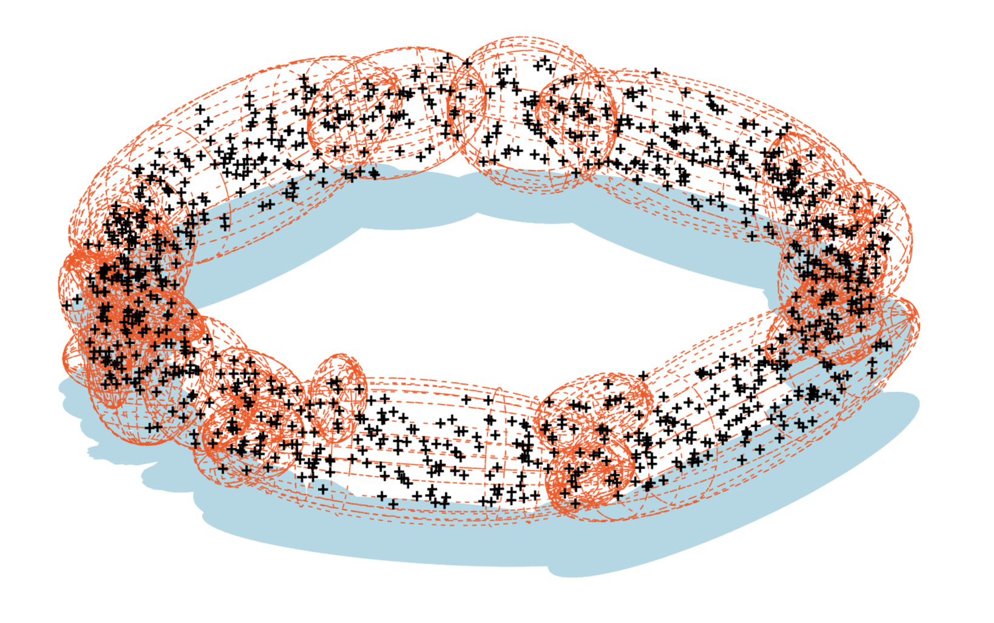
WHAT iS MULTINEST? TOROIDAL POSTERIOR

Slide 9
Part Two:
MultiNest & NEMESIS:
What MultiNest can do for you

Slide 10
WHAT iS MULTINEST? AN INTRO BY EXAMPLE: BROWN DWARF
3D Slice of
17D Hypercube
Data (Near-Infrared Spectrum)
H2O
CH4
NH3

Slide 11
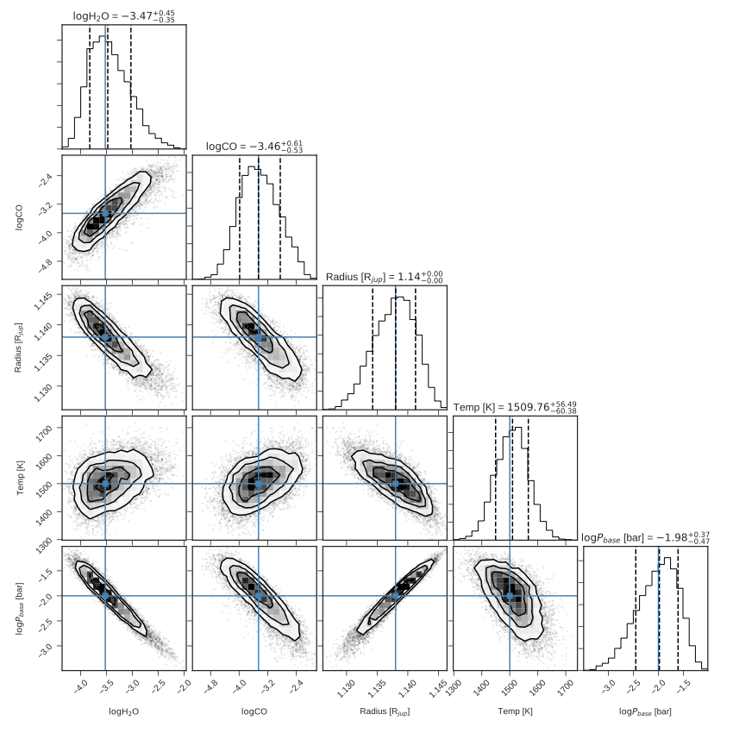
MULTINEST RESULTS: AN INTRO BY EXAMPLE: Primary TRANSIT FAKE DATA

Slide 12
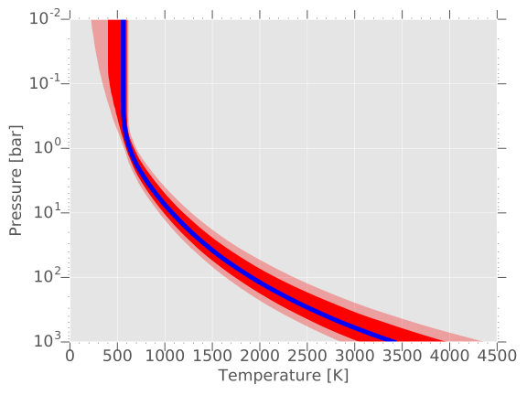
MULTINEST RESULTS: TEMPERATURE PROFILE
Median 1 Sig.
2 Sig.

Slide 13
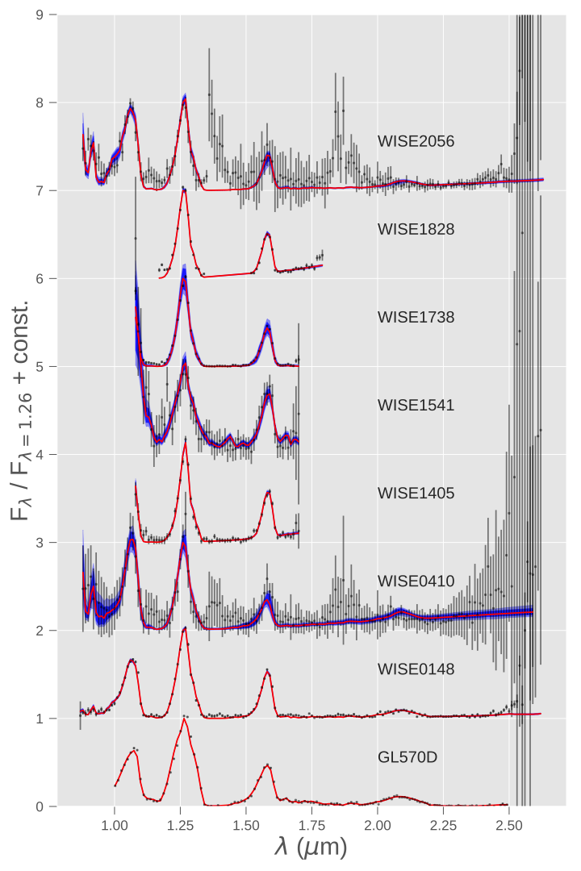
MULTINEST RESULTS:
Spectral fits OF
BROWN DWARFS
Data Median
1 Sig. 2 Sig.

Slide 14
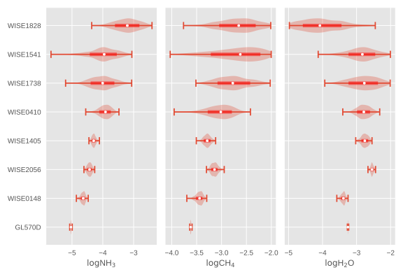
MULTINEST RESULTS: COMPARING POSTERIORS
>Y2
Prob.
Median
<—1 Sigma—>
<———————Extrema————>
T8
log10NH3
log10CH4
log10H2O

Slide 15
MULTINEST USERGUIDE: INSTALLATION
Download latest git version of radtrancode.
External: follow https://johannesbuchner.github.io/PyMultiNest/install.html
Internal: add my LD_LIBRARY_PATH to your .tcshrc file. Also add: module load pymods_trusty to .tcshrc.
Go to Nemesis subfolder in radtrancode, and type e.g.: source nemesisPyMult.comp to create the nemesisPyMult.so shared object file (basically a python library you can import). Do the same for nemesisPT_NS.comp, and any other versions you’d like.
Next is to use the compiled file!

Slide 16
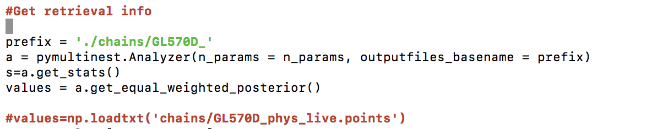

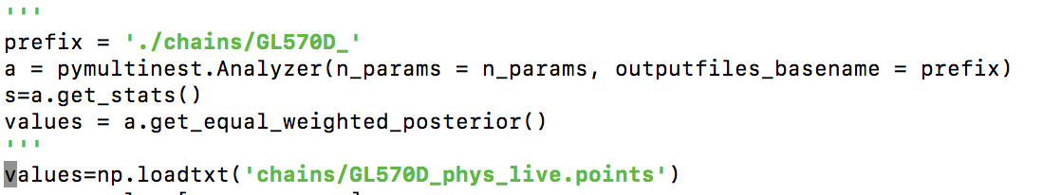
MULTINEST USERGUIDE: SETUP
Create a normal Nemesis folder with all the relevant inputs, as for OE
Switch the number of iterations to -1, and set the .apr file to have zero parameters (*clouds are included in the .apr file, if you wish to have them)
Take these files, and duplicate them so that there are 64 folders (or however many cores you will use), numbered from 0-63. Also create a 999 folder, which is used for plotting.
In the directory containing all of these duplicate folders, copy the .so file from the Nemesis subfolder.
Setup your retrieval in python (see NS_ret.py for example usage) i.e. your forward model and associated hypercube
Run the retrieval (64 is core number, unnecessary text being redirected to trash) with: mpiexec -n 64 python NS_ret.py > /dev/null &
Either wait until the whole retrieval is finished and use NS_plot.py, or modify it slightly to watch convergence occur while the retrieval runs. The modification is done like so (note the triple quotes):

Slide 17
MULTINEST USERGUIDE: NOTES
Temperature and VMRs are passed through with the same number of layers as in the .ref file.
The VMRs must be in the same order as the .ref file. Must sum to 1.0
Mass and radius are in terms of Jupiter, so a 1.0 radius is 69111km
The aforementioned parameters are always passed, as well as pressure, and height (though NEMESIS recalculates height anyway, only the base height is important (0.0 km)).

Slide 18
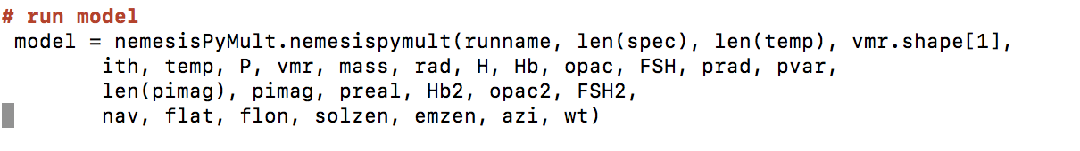
MULTINEST USERGUIDE: PARAMETERS
1. runname: name of nemesis files, e.g. ‘jupiter’ for jupiter.ref.
2. len(spec) = length of spectrum, number of points in .spx file.
3. len(temp) = number of pressure points in .ref.
4. vmr.shape[1] = number of gases in .ref file.
5. ith = i^{th} directory to perform calculation in. Linked to which core is being used.
6. Temp = temperature profile
7. P = pressure profile
8. vmr = vmr profile for all gases
9. Mass = mass in jupiter masses
10. Rad = radius in jupiter radii
11. H = height profile
12. Hb = base height of cloud in km (used for cloud parameterisation #9)
13. Opac = integrated optical depth at specified wavelength (#9)
14. FSH = fractional scale height (#9)
15. prad = particle radius in microns (cloud param #444)
16. pvar = particle size variance in microns (cloud param #444)
17. len(pimag) = number of imaginary indices from refractive index
18. Pimag = imaginary refractive index spectrum
19. PReal = real refractive index at specified wavelength
20. Hb2 = second cloud #9
21. opac2
22. FSH2
23. Nav = number of averaging weights in .spx file
24. Flat = latitudes of weights
25. Flon = longitude of weights
26. Solzen = solar zenith angle
27. Emzen = emission zenith
28. Azi = azimuthal angle
29. Wt = weights

Slide 19
MULTINEST USERGUIDE: PARAMETERS
1. runname: name of nemesis files, e.g. ‘jupiter’ for jupiter.ref.
2. len(spec) = length of spectrum, number of points in .spx file.
3. len(temp) = number of pressure points in .ref.
4. vmr.shape[1] = number of gases in .ref file.
5. ith = i^{th} directory to perform calculation in. Linked to which core is being used.
6. Temp = temperature profile
7. P = pressure profile
8. vmr = vmr profile for all gases
9. Mass = mass in jupiter masses
10. Rad = radius in jupiter radii
11. H = height profile
12. Hb = base height of cloud in km (used for cloud parameterisation #9)
13. Opac = integrated optical depth at specified wavelength (#9)
14. FSH = fractional scale height (#9)
15. prad = particle radius in microns (cloud param #444)
16. pvar = particle size variance in microns (cloud param #444)
17. len(pimag) = number of imaginary indices from refractive index
18. Pimag = imaginary refractive index spectrum
19. PReal = real refractive index at specified wavelength
20. Hb2 = second cloud #9
21. opac2
22. FSH2
23. Nav = number of averaging weights in .spx file
24. Flat = latitudes of weights
25. Flon = longitude of weights
26. Solzen = solar zenith angle
27. Emzen = emission zenith
28. Azi = azimuthal angle
29. Wt = weights
Compulsory parameters

Slide 20
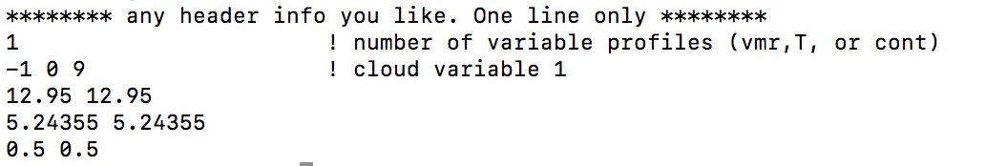
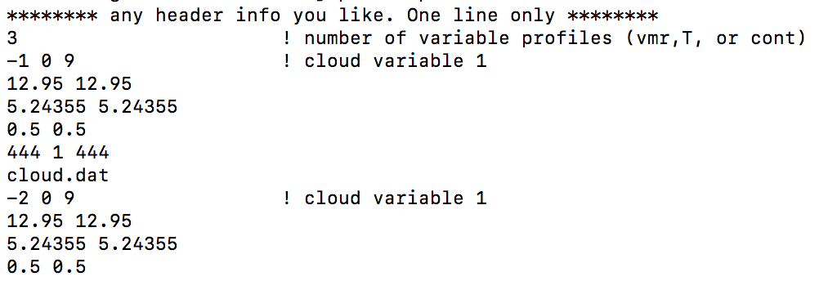
MULTINEST USERGUIDE: PARAMETERS
1. runname: name of nemesis files, e.g. ‘jupiter’ for jupiter.ref.
2. len(spec) = length of spectrum, number of points in .spx file.
3. len(temp) = number of pressure points in .ref.
4. vmr.shape[1] = number of gases in .ref file.
5. ith = i^{th} directory to perform calculation in. Linked to which core is being used.
6. Temp = temperature profile
7. P = pressure profile
8. vmr = vmr profile for all gases
9. Mass = mass in jupiter masses
10. Rad = radius in jupiter radii
11. H = height profile
12. Hb = base height of cloud in km (used for cloud parameterisation #9)
13. Opac = integrated optical depth at specified wavelength (#9)
14. FSH = fractional scale height (#9)
15. prad = particle radius in microns (cloud param #444)
16. pvar = particle size variance in microns (cloud param #444)
17. len(pimag) = number of imaginary indices from refractive index
18. Pimag = imaginary refractive index spectrum
19. PReal = real refractive index at specified wavelength
20. Hb2 = second cloud #9
21. opac2
22. FSH2
23. Nav = number of averaging weights in .spx file
24. Flat = latitudes of weights
25. Flon = longitude of weights
26. Solzen = solar zenith angle
27. Emzen = emission zenith
28. Azi = azimuthal angle
29. Wt = weights
Cloud parameters are read in IF the appropriate .apr parameters have been inserted. If .apr is empty, then any placeholder values can be used as the clouds are not included in the retrieval.

Slide 21
MULTINEST USERGUIDE: PARAMETERS
1. runname: name of nemesis files, e.g. ‘jupiter’ for jupiter.ref.
2. len(spec) = length of spectrum, number of points in .spx file.
3. len(temp) = number of pressure points in .ref.
4. vmr.shape[1] = number of gases in .ref file.
5. ith = i^{th} directory to perform calculation in. Linked to which core is being used.
6. Temp = temperature profile
7. P = pressure profile
8. vmr = vmr profile for all gases
9. Mass = mass in jupiter masses
10. Rad = radius in jupiter radii
11. H = height profile
12. Hb = base height of cloud in km (used for cloud parameterisation #9)
13. Opac = integrated optical depth at specified wavelength (#9)
14. FSH = fractional scale height (#9)
15. prad = particle radius in microns (cloud param #444)
16. pvar = particle size variance in microns (cloud param #444)
17. len(pimag) = number of imaginary indices from refractive index
18. Pimag = imaginary refractive index spectrum
19. PReal = real refractive index at specified wavelength
20. Hb2 = second cloud #9
21. opac2
22. FSH2
23. Nav = number of averaging weights in .spx file
24. Flat = latitudes of weights
25. Flon = longitude of weights
26. Solzen = solar zenith angle
27. Emzen = emission zenith
28. Azi = azimuthal angle
29. Wt = weights
If nav = 0, then .spx file is used normally. Otherwise, you can put in your own averaging weights.

Slide 22
MULTINEST USERGUIDE: EXAMPLES
Examples are given in ~garland/NS_EXAMPLES/
I suggest you follow the installation instructions, copy the BASIC_BD_RET example somewhere, copy in your new .so file, and then run as per instructions. Check out the plots from NS_plot, and see if they look sensible!

